Slide 1
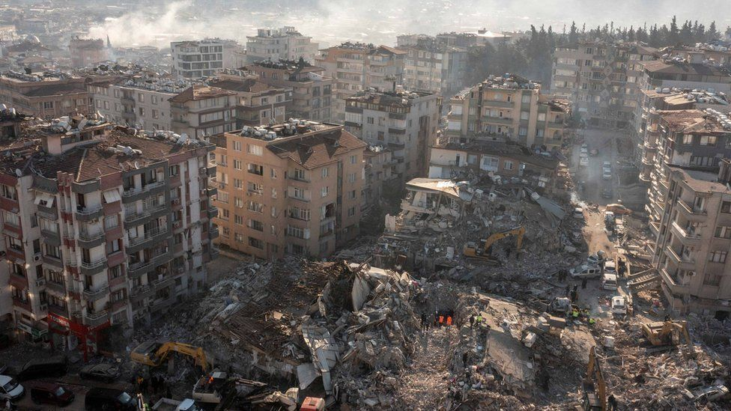
Rescue Trainer
@CNBC​
Simantini Shinde
Final Project Presentation
Spiced Academy
04.04.2023

Slide 2
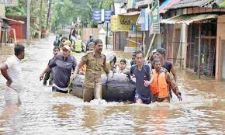
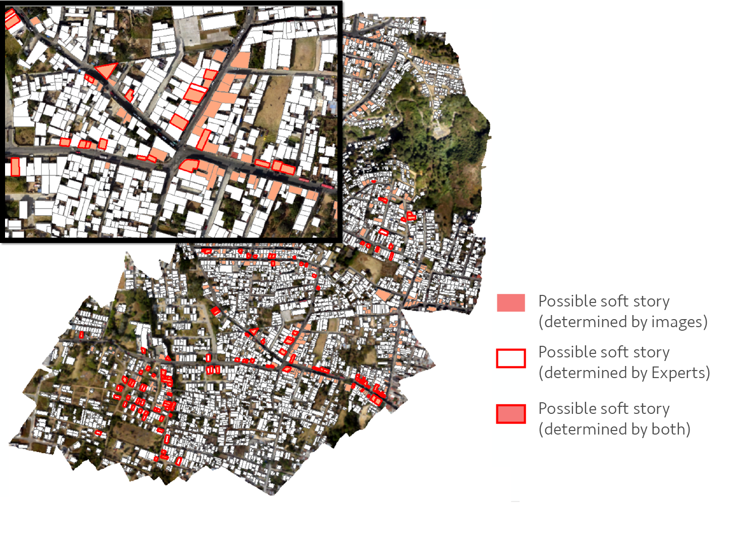
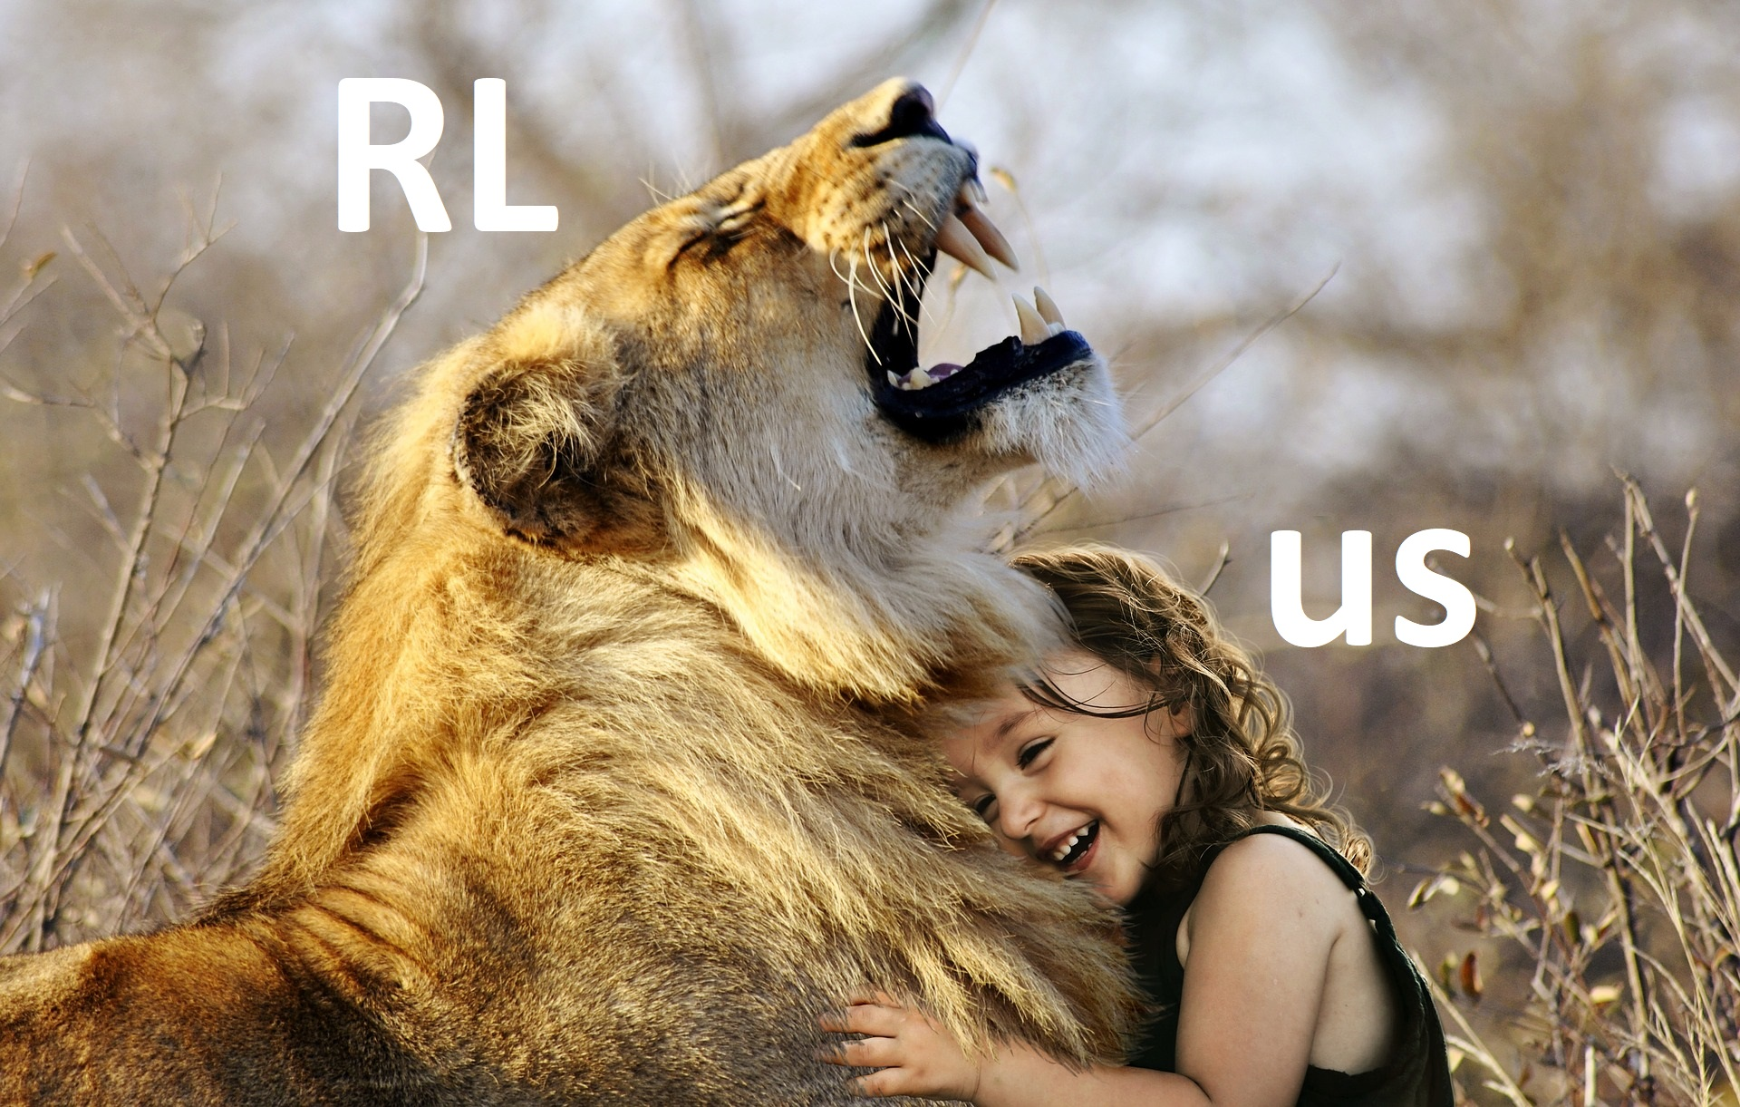
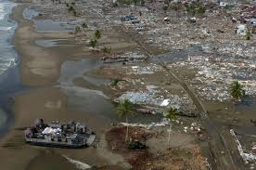
WHY ?
@HansIndia @WorldBank Blogs @Wikipedia @Deeplizard
Notes:
Disaster Planning
Mock Disaster Rescue Trainings
Training Drones to scour the disaster area
DATA SHORTAGE
DATA UNRELIABILITY
Variable ENVIRONMENTS
A CLEAR FUTURE

Slide 3
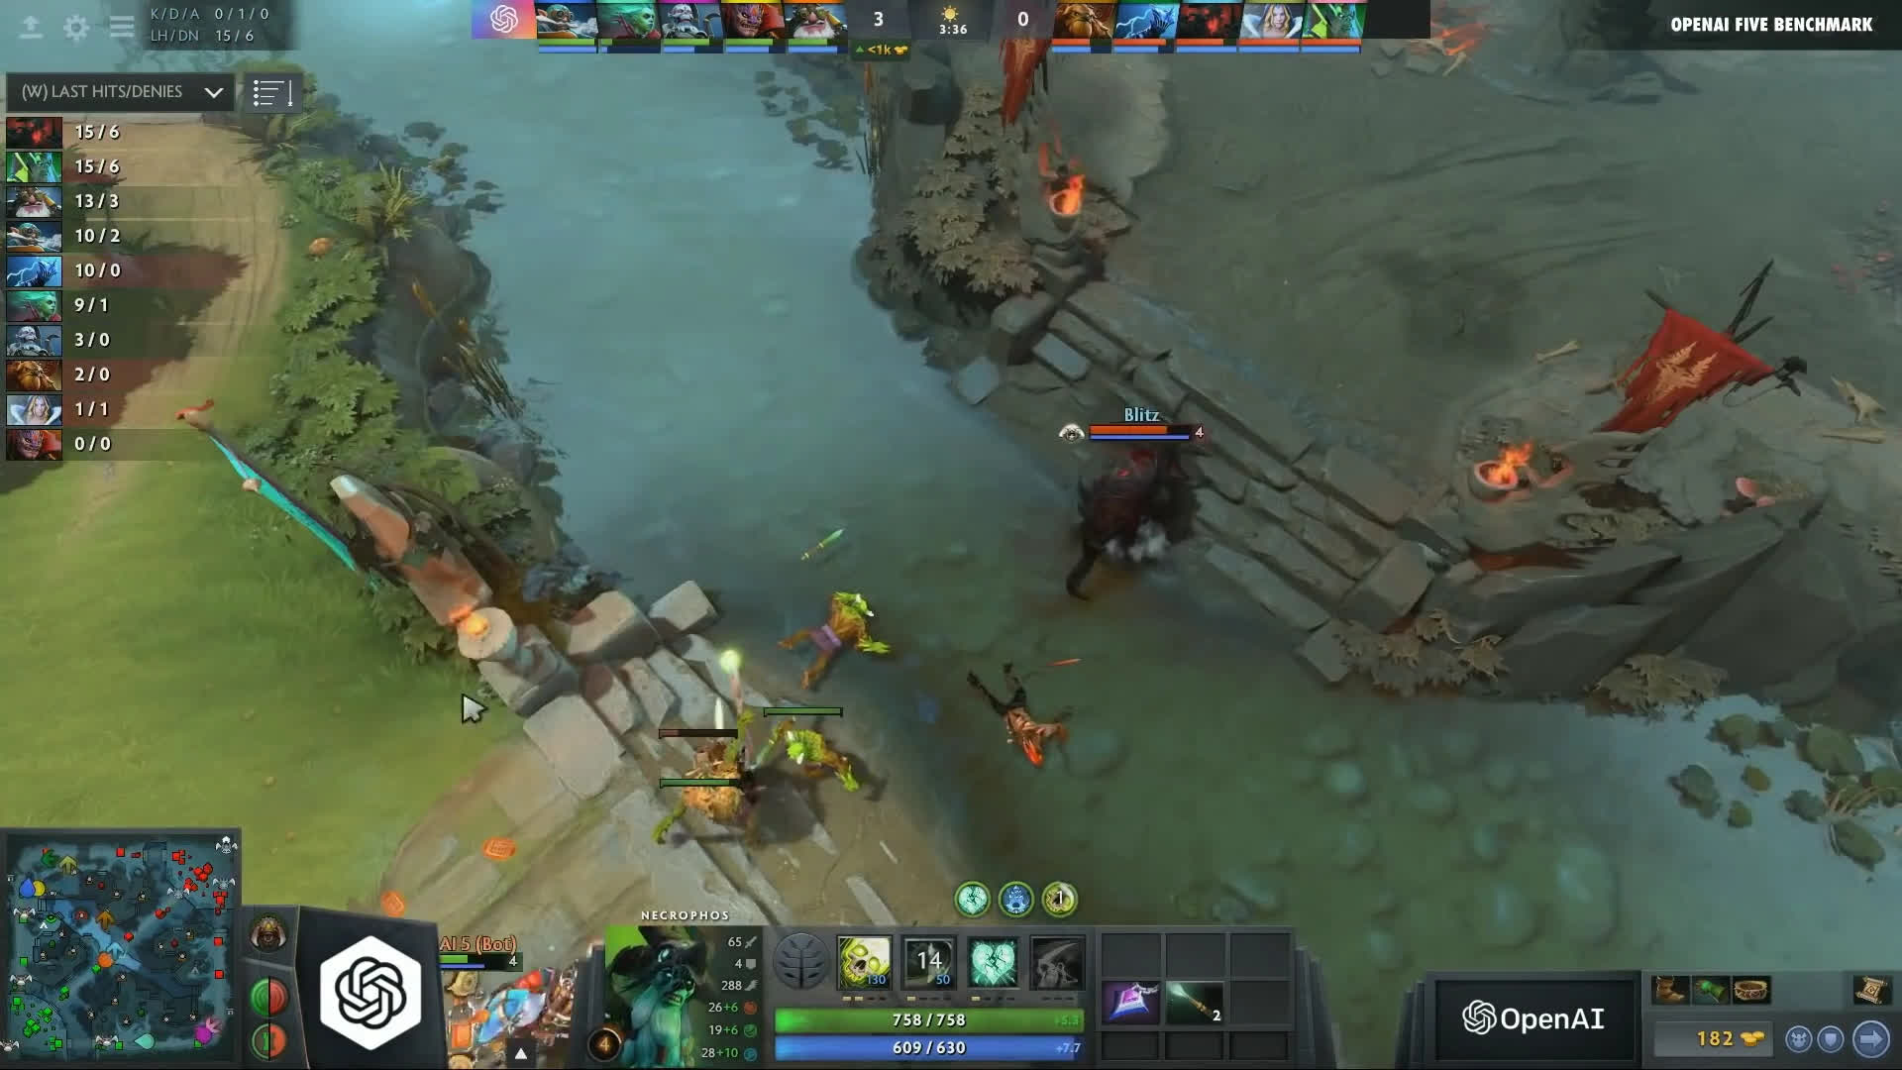
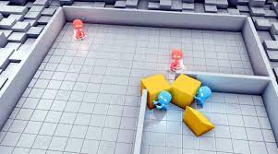
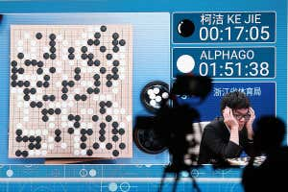
RL IS CRAZY AWESOME!!
Open AI Five defeated Dota2 World Champions
4 Agents playing a competitive game of Hide and Seek
Google DeepMind’s Go beats Ke Jie, the world’s number one player.
@New Scientist @OpenAI @FinancialTimes
Notes:
VARY

Slide 4


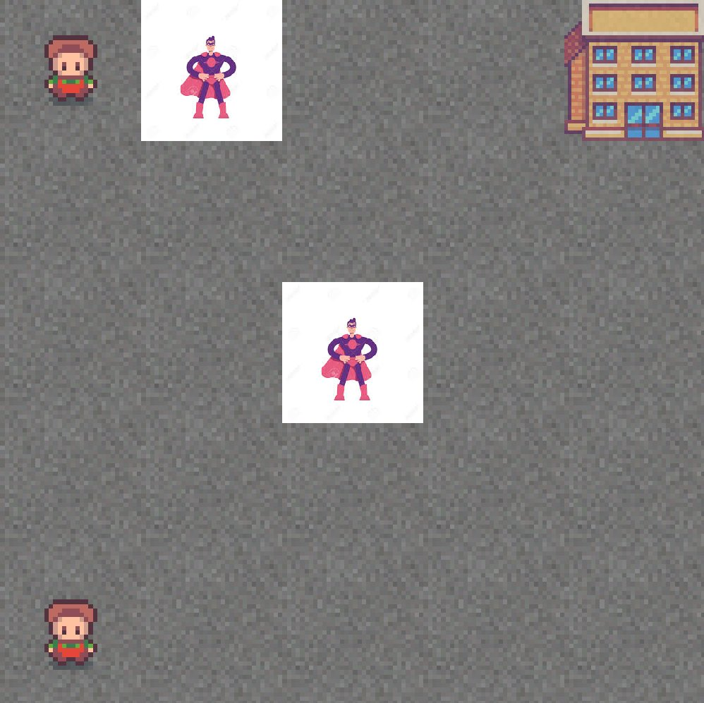
Reinforcement Learning
Markov Decision Process: Sequential Decision making
@Sutton & Brato

Slide 5


What is a Rescue Trainer
Multi-Agent Reinforcement Learning based model.
Multiple agents (rescuer's) pick up multiple victims and drop them off at a Hospital.

Slide 6
Rescue Trainer Environment
5x5 grid.
Locations of the victims changes within 3 locations.
A single rescue zone (cell).
Action | Reward
Left, right, up, down | -1
Wrong pick up or drop | -10
Drop one victim | 20
Dropped two victims | 30
Victims Locations
Victim Icon
Agent
Hospital Location

Slide 7
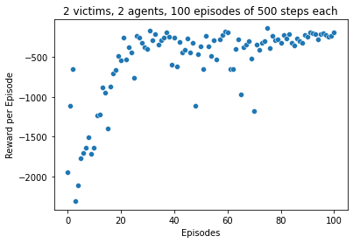
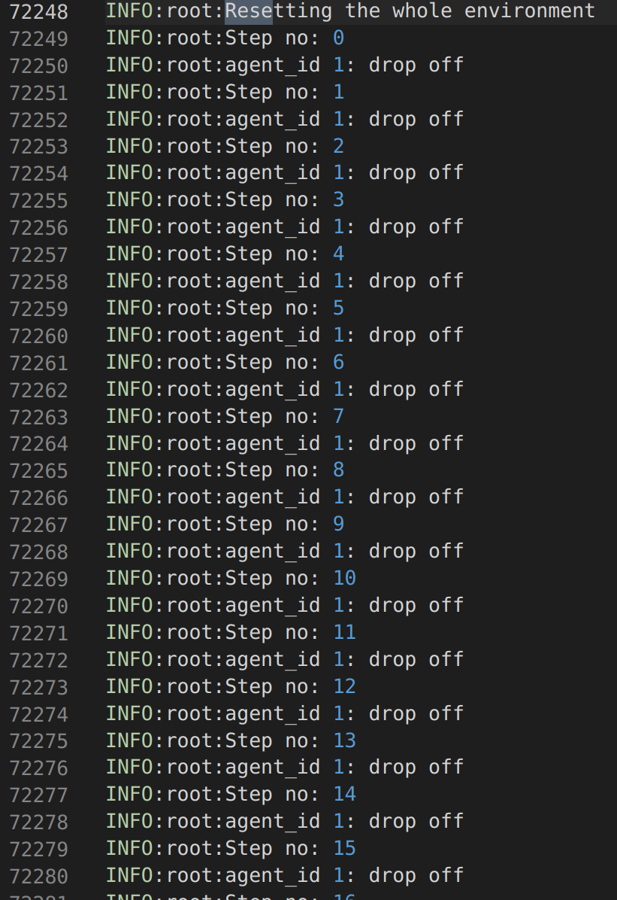
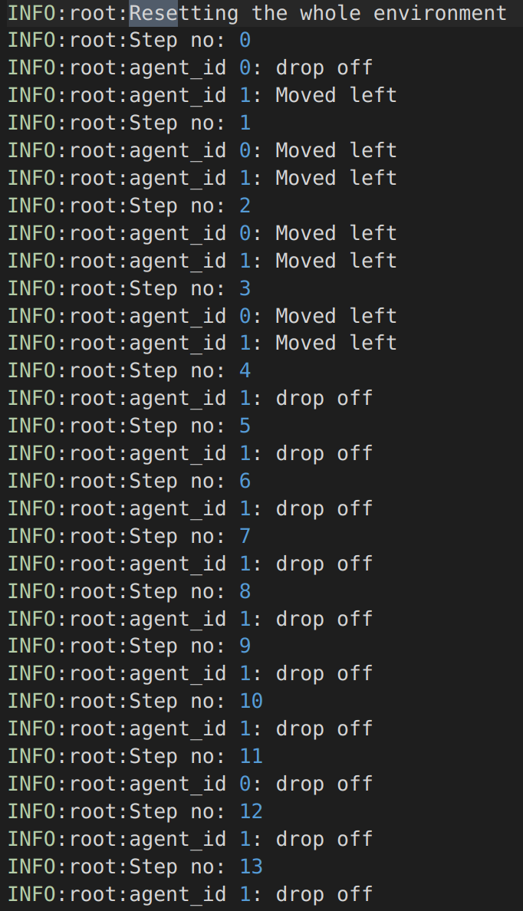
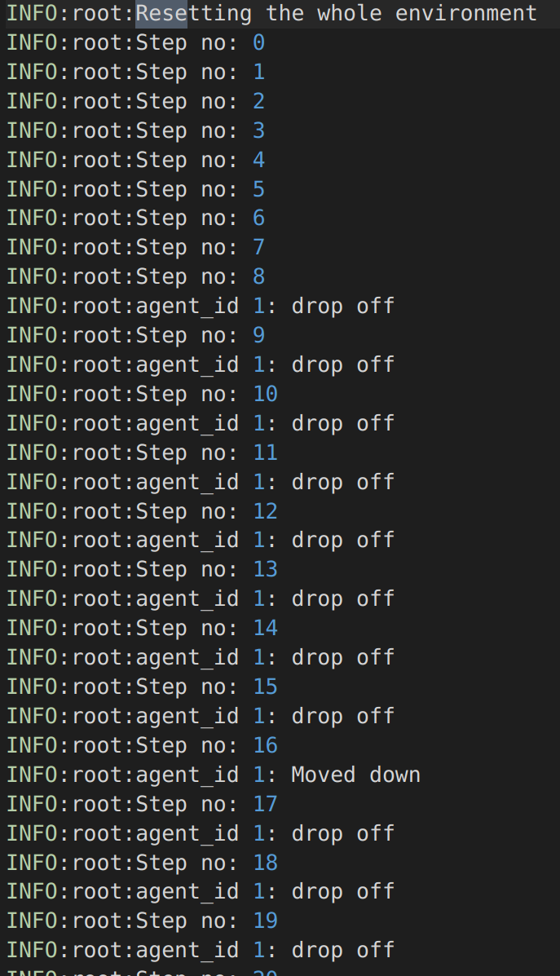
Model results
Both Victims dropped (in no. of Steps) | Episode No.
304 | 3
433 | 4
495 | 11
294 | 25
220 | 26
417 | 29
Still Exploring
"Are the rewards getting better" !!!
Does it do the job I am asking it to do ?
What is the reward policy ?
46 times --> Dropped off 1 victim

Slide 8
First 500 steps for a 20 episode (training) model

Slide 9
Future Steps
Bigger Map/grid --> With roads and blockages
Deep learning models/Policies --> Agent-Critic or Policy Approximation.
Number of victims is initialized from the loss probabilities of the buildings.
Rescuer's initialized directly proportional to the number of victims.

Slide 10
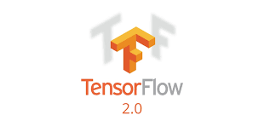





Sources and Packages
GYM Open AI
RLlib
Pygame

Slide 11
Thank You

Slide 12
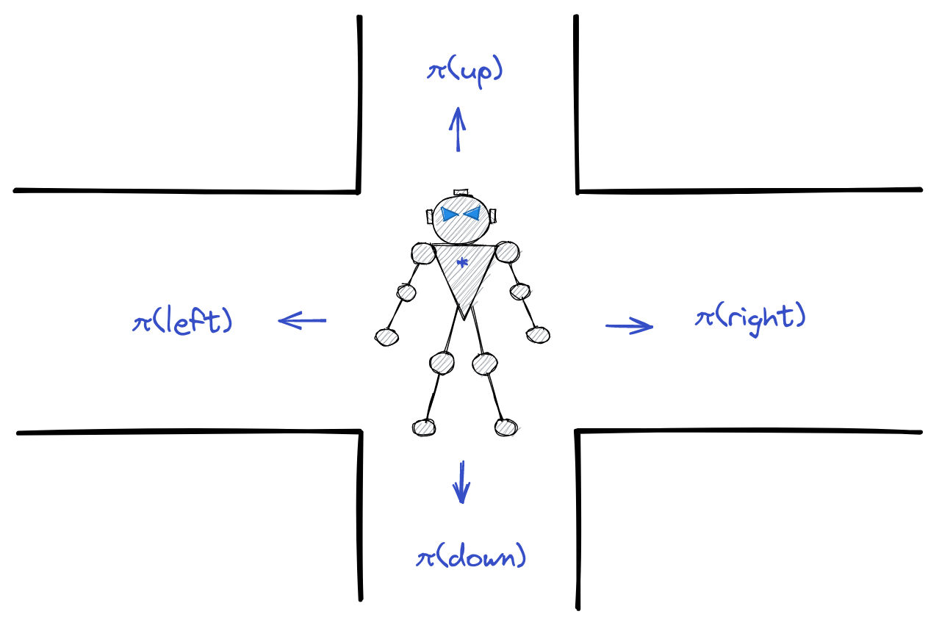
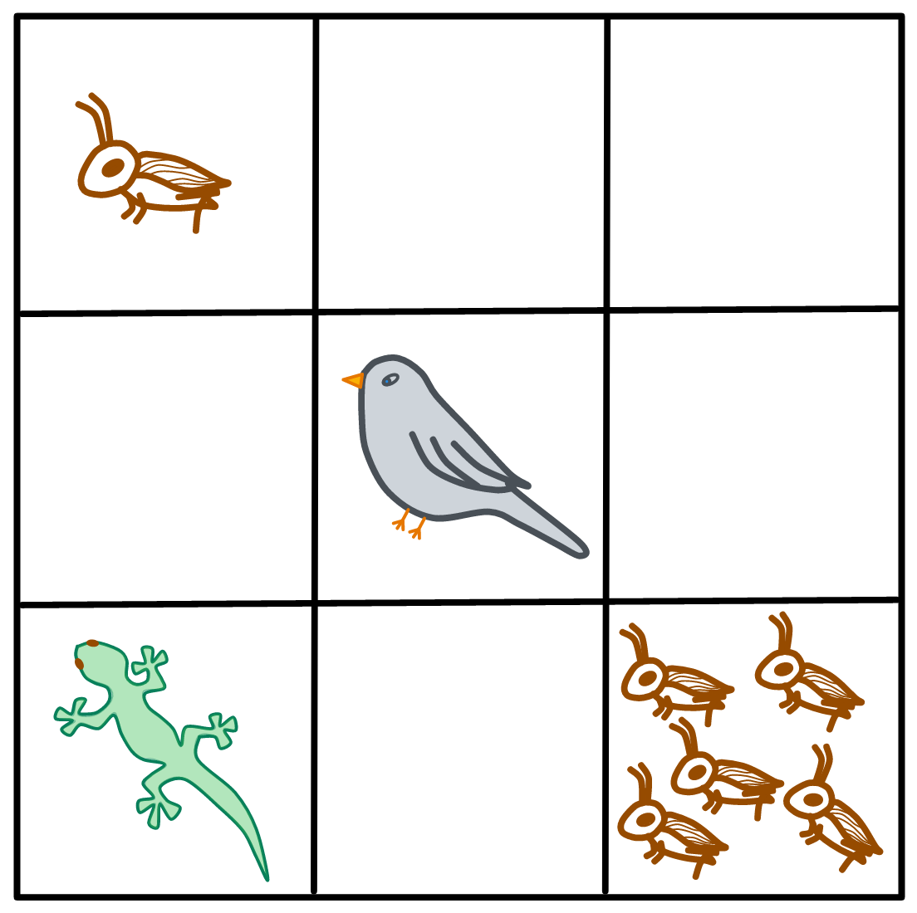
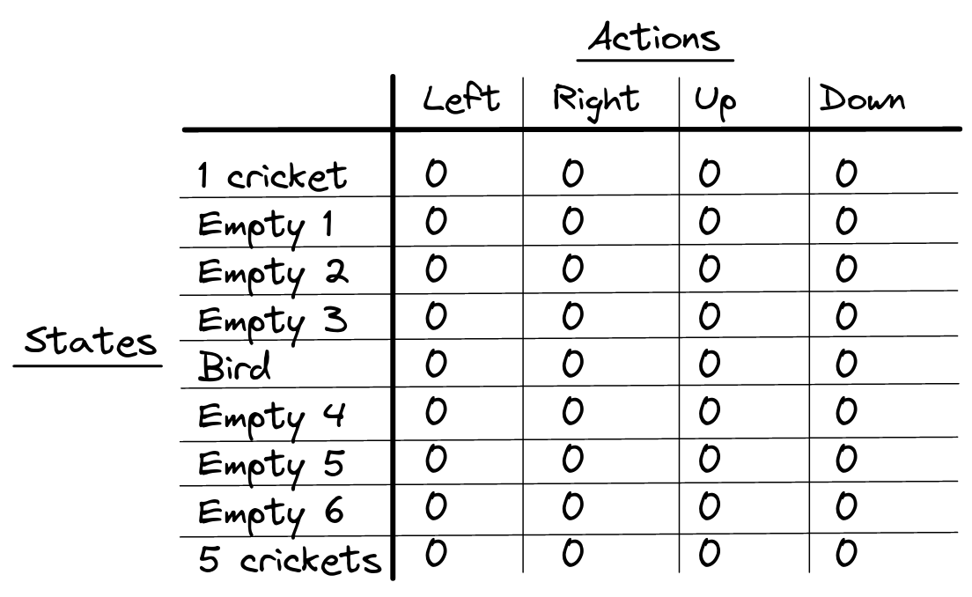
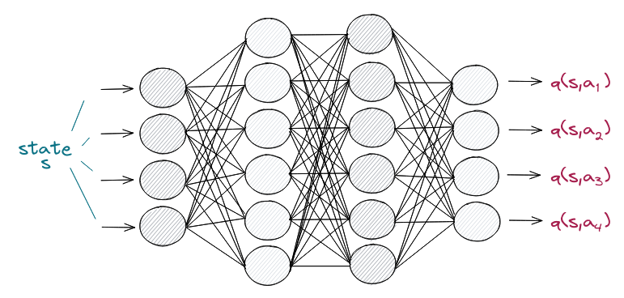
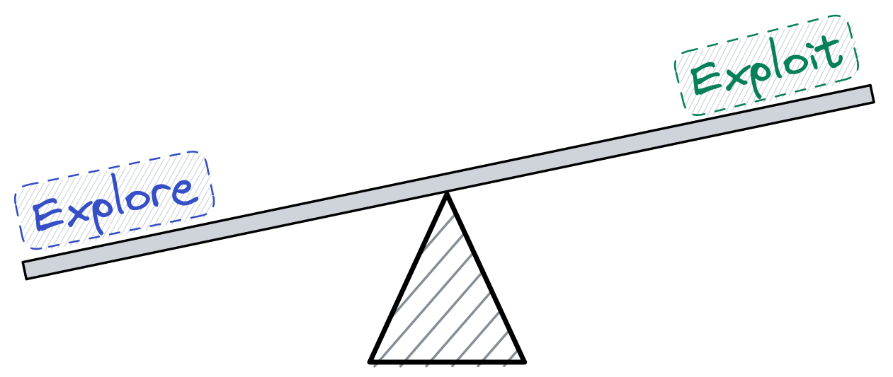
Q-Learning and Deep Q-Learning
Q Learning​
Policies
Deep Q Learning​
Notes:
Policies: A policy is a function that maps a given state to probabilities of selecting each possible action from that state
Q Learning: The objective of Q-learning is to find a policy that is optimal in the sense that the expected value of the total reward over all successive steps is the maximum achievable.
E: To get this balance between exploitation and exploration, we use what is called an epsilon greedy strategy. With this strategy, we define an exploration rate that we initially set to .

Slide 13
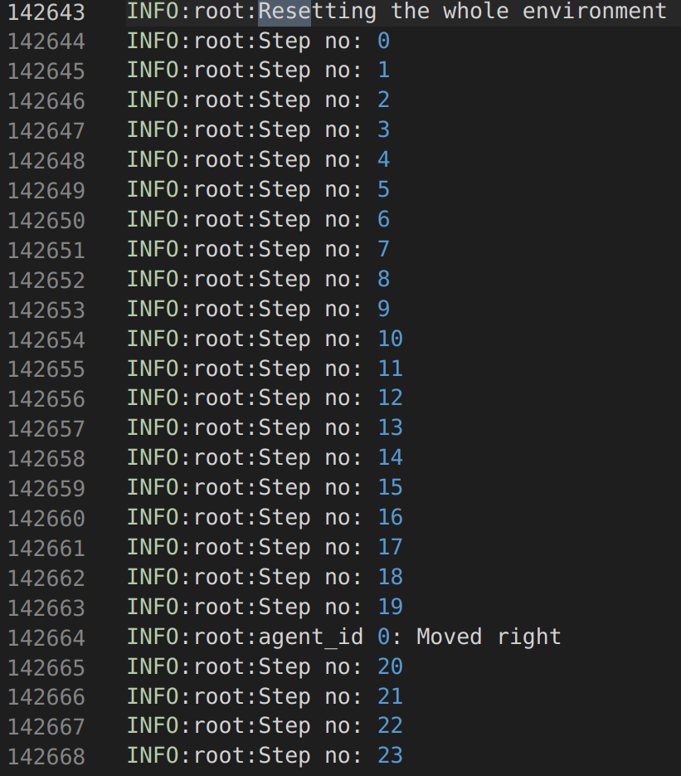
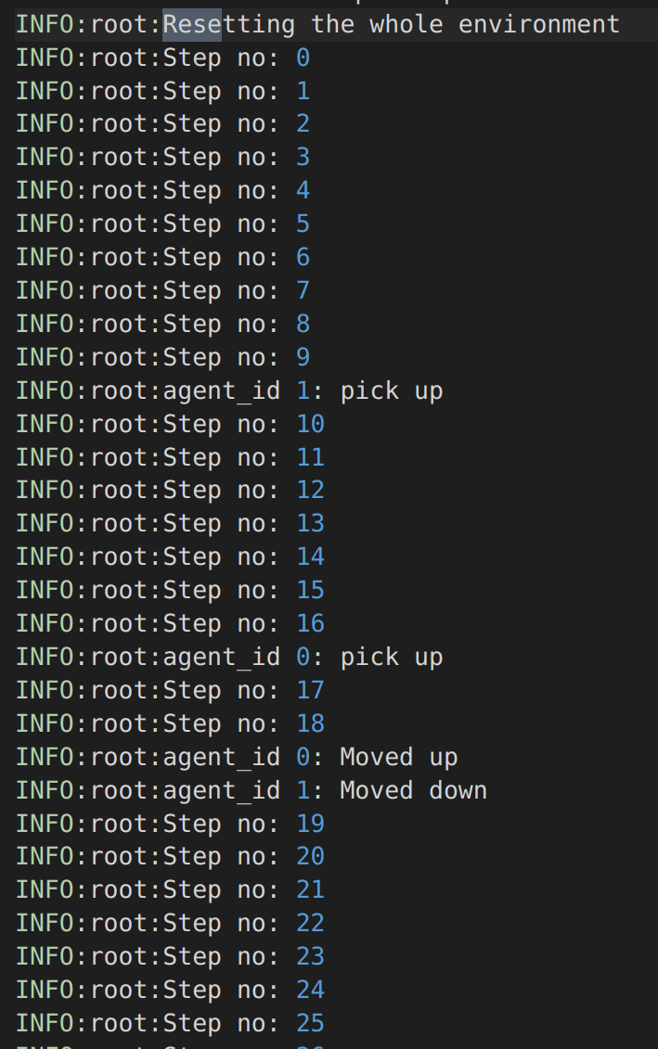
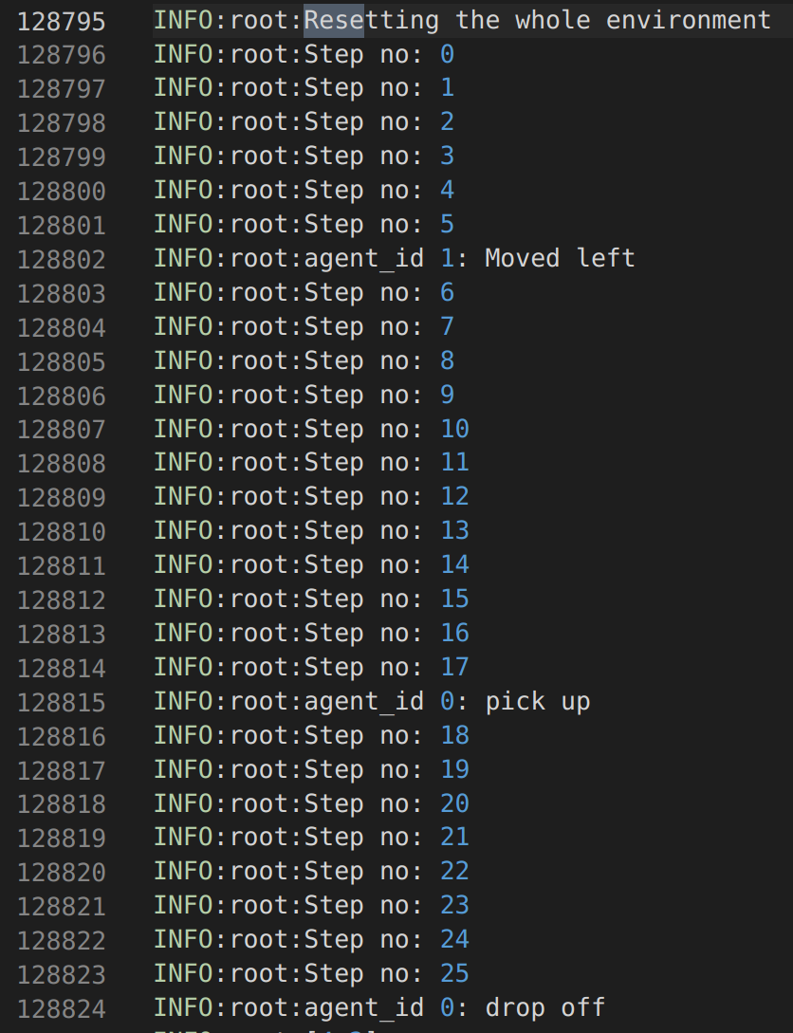
Policy Gradient Challenges: 125 Episodes
Agent Gets Stuck (A LOTTTTTT)
Dropping Victims at the Rescue location
46 times --> Dropped off
Only Keeps Dropping !!!

Slide 14
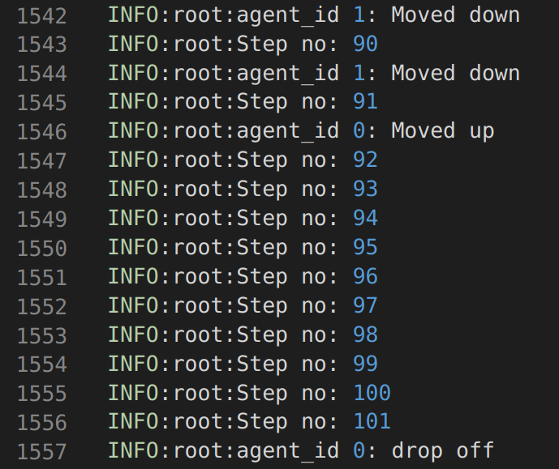
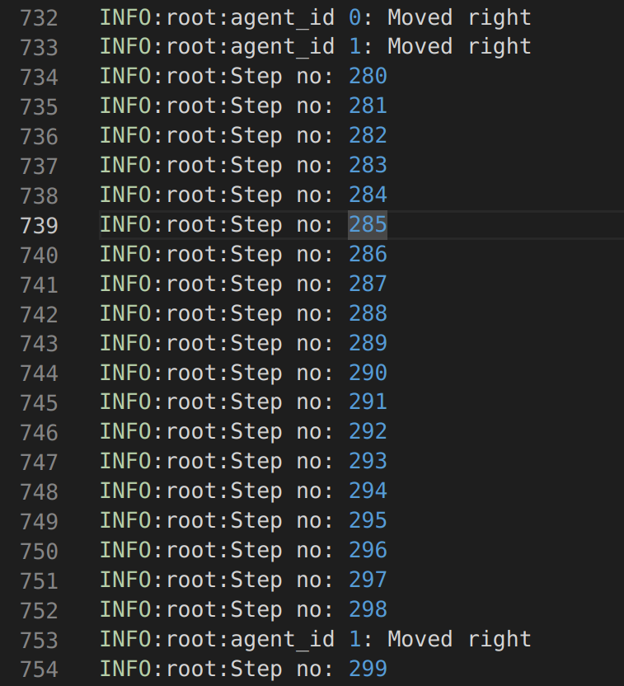
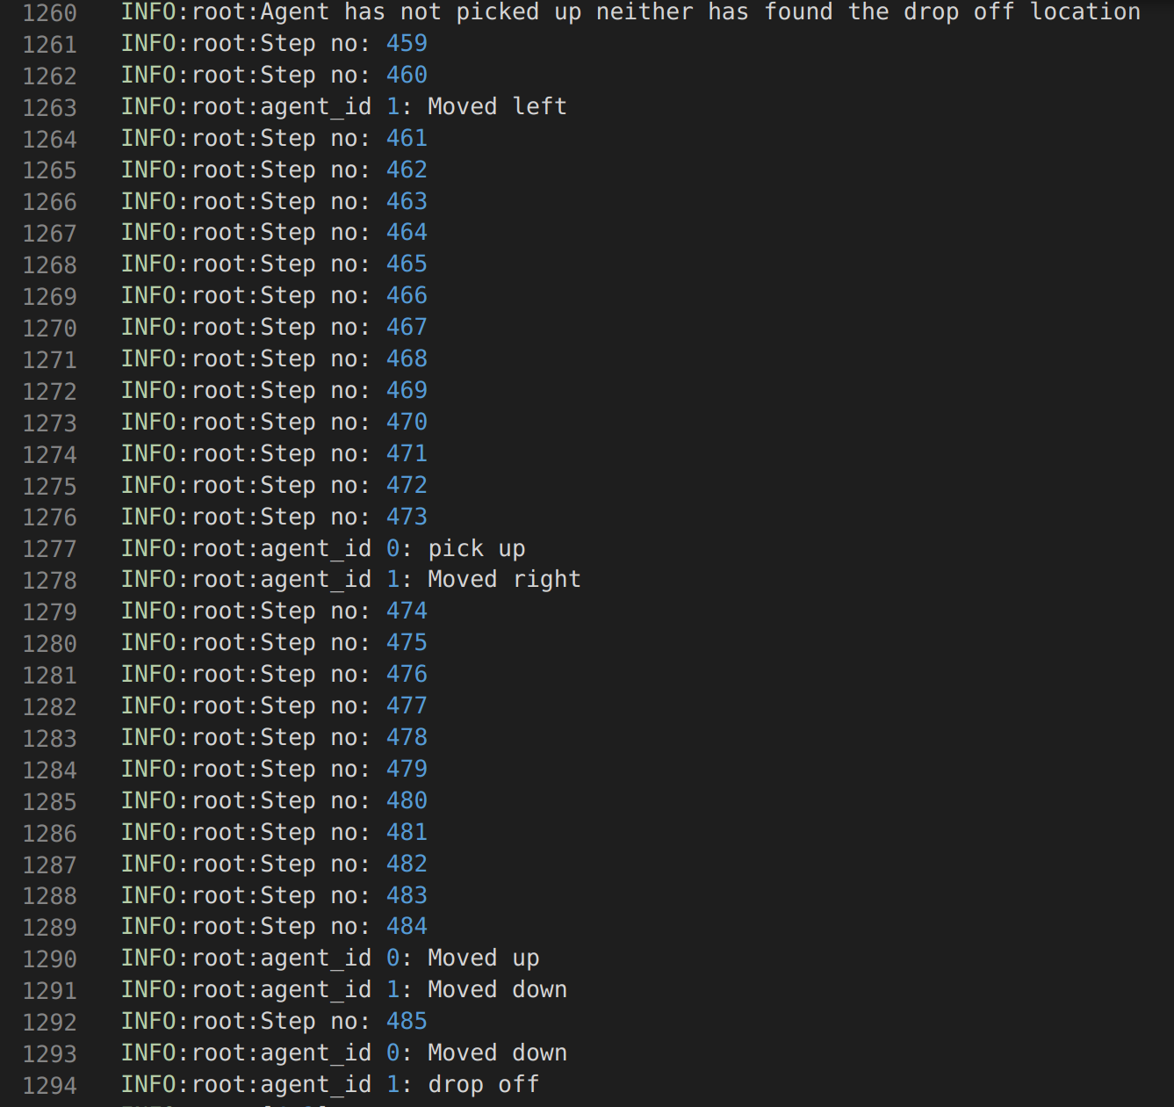
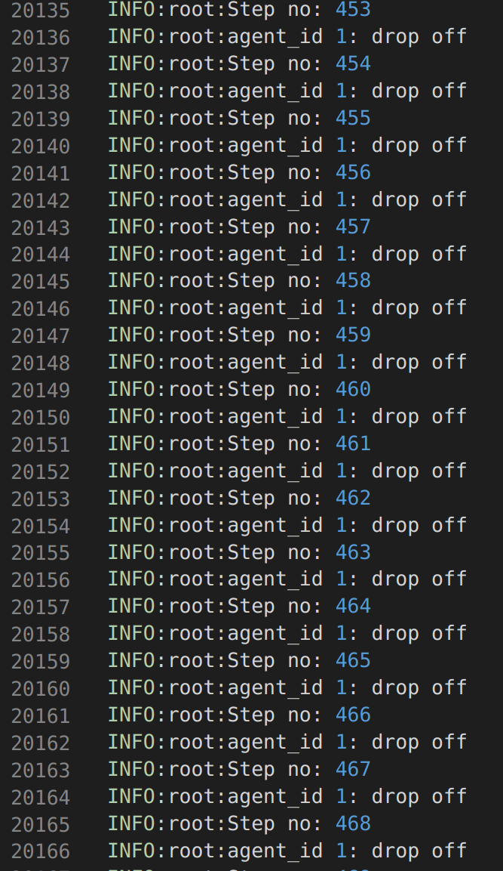
Policy Gradient Challenge: 20 Episodes
Dropping Victims at the Rescue location
Agent Gets Stuck (A LOTTTTTT)
4/20 --> Dropped off i.e. 10,000 steps
Victim at [0,0] dropped 3 times
Only Keeps Dropping !!!

Slide 15
RL takes into account many aspects
It is not as straightforward as "Are the rewards getting better"
My model learnt that dropping is the way to higher
Does it do the job I am asking it to do ?
What is the reward policy ?
https://towardsdatascience.com/the-complete-reinforcement-learning-dictionary-e16230b7d24e
RL Agent also gets stuck a lot
https://www.reddit.com/r/reinforcementlearning/comments/cm7yu4/how_to_deal_with_rl_algos_getting_stuck_in_local/

Slide 16
Why Reinforcement Learning
DATA SHORTAGE
ENVIRONMENTS
VARY
A CLEAR FUTURE
DATA UNRELIABILITY

